Slide 1
Unclassified Cover Slide
Joint Medical Acquisition Talks (JMAT) 2026
July 14-15, 2026
Last updated: June 29, 2026

Slide 2
Welcome and Opening Remarks
Rachel Ganaway
Director – Strategic Initiative Group
DLA Troop Support

Slide 3
Keynote Address
Colonel Chad Handley
Director, Medical Supply Chain
DLA Troop Support

Slide 4
DLA/DHA Partnership
William Kenny
Executive Director, Contracting and Acquisition Management
DLA Troop Support
Brett Scheideman
Acting Principal Deputy
Defense Health Agency

Slide 5
Roles Among DLA, DHA, VA, Services and MTFs
Rachel Ganaway
Director – Strategic Initiative Group
DLA Troop Support

Slide 6
Cybersecurity and ATO
Placeholder slide. Cybersecurity and ATO presentation by Defense Health Agency.

Slide 7
Unclassified Cover Slide
Trade Agreements Act (TAA) and Regulatory Updates
Michael Baron,
Contract Specialist, DLA Troop Support
Katherine McCulloch, Senior Counsel, DLA Troop Support
July 14, 2026
Last updated: June 25, 2026

Slide 8
Agenda
Agenda:
  FAR and DFARS Overhaul
  Regulatory Tracking
  Trade Agreements Act Provision/Clause Overview
  Questions

Slide 9
Disclaimer
DISCLAIMER:
  The content on this presentation is for informational purposes only and does not constitute legal advice. No attorney-client relationship is formed by reading this content. Please consult a licensed attorney for advice regarding your specific situation.
  If you have questions pertaining to performance or items covered by a contract with DLA Troop Support, contact your Contracting Officer for that contract.

Slide 10
FAR/DFARS Overhaul
Revolutionary FAR Overhaul
  The Revolutionary FAR Overhaul (RFO) is a government‑wide initiative to comprehensively streamline and simplify the Federal Acquisition Regulation (FAR) by “returning it to its statutory and executive order origins, rewriting it in plain language, and retaining policies for sound procurement.”
  Currently implemented through a series of deviations located here:
  https://www.acquisition.gov/far-overhaul
  Will eventually follow standard notice and comment procedures - proposed rules are being drafted.

Slide 11
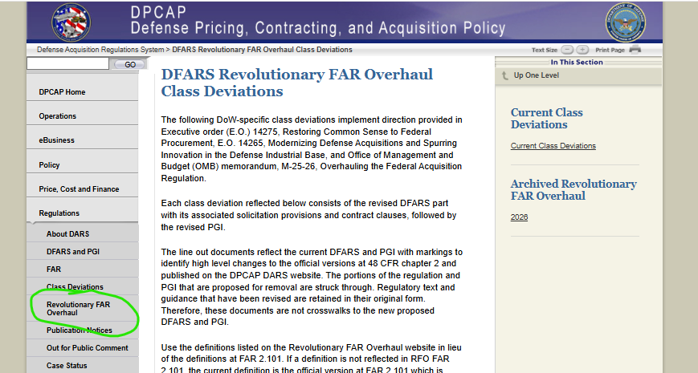
FAR/DFARS Overhaul (Cont.)
DFARS Overhaul
  DFARS Overhaul Deviations in effect are located on the Defense Pricing, Contracting, and Acquisition Policy (DPCAP) DFARS webpage:
https://www.acq.osd.mil/dpap/dars/dfars_far_overhaul_class_deviations.html

Slide 12
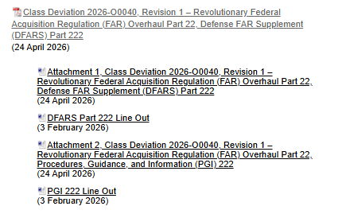
FAR/DFARS Overhaul (Cont.)
Each deviation comes with an effective date, DFARS part and line-out, DFARS PGI and line-out.
The Deviation Document typically includes the adoption of the Revolutionary FAR Overhaul (RFO) Part.
DFARS Clauses are typically included in Attachment 1 along with the text of the DFARS Part. There is no separate deviation for Part 252.

Slide 13
FAR/DFARS Overhaul (Cont.)
The transition from the old FAR/DFARS to the Overhaul is an ongoing process that depends largely on whether a solicitation/contract began before DoW’s adoption of the overhaul deviations.
Any new solicitations going forward will likely be using the Overhaul provisions and clauses, existing solicitations/contracts may be amended/modified.

Slide 14
Regulatory Tracking
Potential Sources of Change to the FAR/DFARS
Statute (e.g. FY NDAA)
Executive Order
FAR/DAR Council and OFPP (Policy Concerns, Litigation)
Many of these changes are tracked through FAR/DFARS cases available on
the Defense Pricing, Contracting, and Acquisition Policy (DPCAP) website.
https://www.acq.osd.mil/dpap/dars/dfarspgi/current/index.html

Slide 15
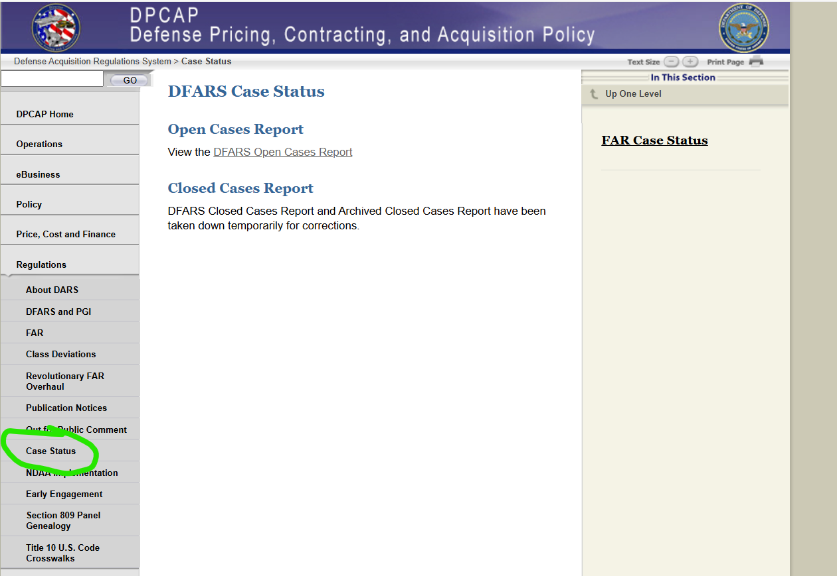
Regulatory Tracking (Cont.)
Current FAR/DFARS Cases and their status are available on the Defense Pricing, Contracting, and Acquisition Policy (DPCAP) website:

Slide 16
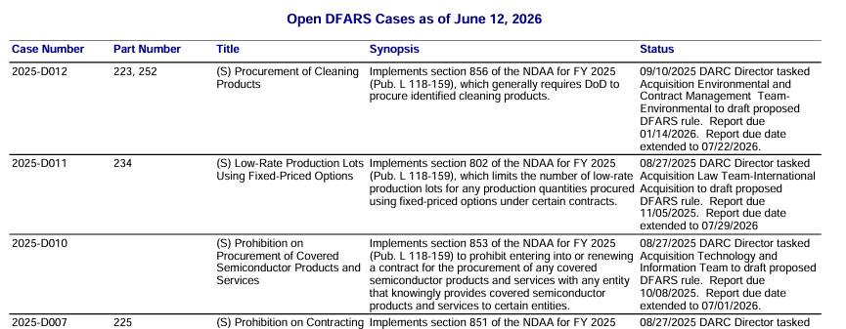
Regulatory Tracking (Cont.)
  This report is issued at the end of each week, so vendors can follow each cases development from initiation, to draft rules (including comment periods), to final rules. Cases typically take a long time from start to finish, as policy or legislation shifts can affect their development.
Notes:
Some cases never complete the process.

Slide 17
Regulatory Tracking (Cont.)
Current Case Lists Cover Potentially Applicable Issues
  Acquisition Regulations
  (a) FAR Overhaul (FAR Cases 2026-001 through 2026-012)
  (b) Unsuccessful Offeror Explanations on Certain Orders under Task/Delivery Contracts (FAR Case 2020-005)
  Sourcing Issues:
  (a) Chinese Military Companies Operating in the US (DFARS Case 2024-D012);
  (b) Batteries from certain companies (DFARS Case 2024-D011)
  (c) Batteries containing rare earth elements from certain countries (DFARS Case 2023-D003)
  (d) Semiconductors (FAR Case 2023-0008)
  (e) Printed Circuit Boards from certain countries (DFARS Case 2022-D011)
  (f) Disclosing Foreign Obligations (DFARS Case 2018-D064)
  (3) Cybersecurity Requirements:
  (a) Incorporation of NIST SP 800-172 into DFARS clause 252.204-7012 (DFARS Case 2023-D024)
  (b) Efforts under Executive Order 14028 (FAR Cases 2021-017 and 2021-019)
  (c) Cybersecurity Maturity Model Certification (CMMC) Program (Rule issued)

Slide 18
Regulatory Tracking (Cont.)
Cybersecurity Maturity Model Certification (CMMC) Program (Rule Issued)
252.204-7021/252.204-7025
    DFARS Overhaul 240.371-5(a)(1): Until November 9, 2028, in solicitations and contracts, task orders, or delivery orders, including those using FAR part 12 procedures for the acquisition of commercial products and commercial services, except for solicitations and contracts or orders solely for the acquisition of commercially available off-the-shelf (COTS) items, if the program office or requiring activity determines that the contractor is required to have a specific CMMC level.
  The CMMC level determination depends on the involvement of Federally Controlled Information (FCI) or Controlled Unclassified Information (CUI) in contractual performance.
  There are no determinations yet regarding the Capital Equipment Division’s product lines. This is a developing situation.

Slide 19
Regulatory Updates
DFARS Case 2018-D064 regarding Disclosure of Foreign Obligations:
Source: Section 1655 of 2019 NDAA (Pub. L. 115-32)
Stage: Reviewing comments to draft rule (89 FR 90254) and drafting final rule
  The proposed rule implements section 1655 of the NDAA for FY 2019, which prohibits DoW from acquiring products, services, or systems relating to information or operational technology, cybersecurity, industrial control systems, or weapon systems through a contract unless the offeror or contractor provides disclosures related to sharing source code and computer code with foreign persons or governments.
  According to the publication of the draft rule, DoW intends to apply the proposed rule to contracts at or below the SAT and DoW intends to apply the proposed rule to contracts for the acquisition of commercial products including COTS items and for the acquisition of commercial services.

Slide 20
Trade Agreements
Clause 252.225-7021 Trade Agreements – Basic (FEB 2024)
Included in solicitations for eligible products (including PSG 65) instead of Buy American, when the acquisition value exceeds $174,000, barring an exception in FAR 25.401(a)
The Contractor shall deliver only U.S.-made end products, Qualify Country end products, or Designated Country end products. The rule for determining the country of origin is different for each of these.
Limited exceptions when TAA included in the solicitation/contract:
1) The solicitation/contract specifies exempt items in the Schedule
2) The Contractor specified delivery of non-TAA compliant products in its offer and:
i) insufficient responsive, responsible offers of compliant products ,or
ii) national interest waiver
Source: DFARS Overhaul Deviation 2026-O0041 (February 2026) 225.601(6), 252.225-7021(b) and (c)
Note: The DFARS Overhaul Deviation did not change the existing clause

Slide 21
Trade Agreements (Cont.)
Provision 252.225-7020 Trade Agreements Certificate – Basic (Nov 2014)
Three paragraphs:
Paragraphs (a) and (b) discuss definitions and evaluations
Paragraph (c) is the offeror’s certification of delivery of U.S.-made, Qualifying Country, or Designated Country end products, and provides a fill-in for the offeror to disclose any nondesignated country end products. When Paragraph (c) is left blank in a submitted certificate, and the offer does not otherwise indicate anything other than a TAA compliant product, the offeror is certifying all end products are TAA compliant (i.e. U.S.-made, qualifying country, or designated country end products). Wyse Technology, Inc. B-297454, Jan 24, 2006. p. 6.
Solicitations may require further information relating to TAA compliance
The certification is subject to the False Claims Act, 31 U.S.C. 3729 et. seq.
Certification located at DFARS Overhaul Deviation 2026-O0041 (February 2026) 252.225-7020
Note: The DFARS Overhaul Deviation did not change the existing provision

Slide 22
Trade Agreements (Cont.)
Relevant Decisions
The Face of the Proposal
  Pre-award, an agency may reasonably rely on a firm’s representation of TAA compliant end products without further investigation, unless the agency has reason to believe otherwise. HPI Federal, LLC, B-422583, August 9, 2024, p. 5.
  Further, an agency is not required to look beyond the face of the proposal when nothing included in the proposal reasonably indicates the possibility of non-compliance. W&K Container, Inc. B-422234.2, March 12, 2024 pgs. 7-8. HPI Federal B-422234.2, August 9, 2024, pgs. 8-9.
Notes:
This has been upheld despite potential “indicators” such as a substantially lower price, previous non-compliance under another contract, or existence of alleged contradictory information available through public sources. W&K Container (Lot 1 discussion) and HPI Federal (docking station discussion).

Slide 23
Trade Agreements (Cont.)
Relevant Decisions (cont.)
The Face of the Proposal (cont.)
  However, an agency may, in its discretion, look beyond the proposal even when there is no indication of non-compliance within the proposal. See Master Lock Company, LLC, B-309982.2, June 24, 2008.
  When inquiring about a proposal’s TAA compliance, the depth of the investigation can depend on what triggered the inquiry including whether it resulted from information outside the proposal or apparent deficiencies within the proposal. See Master Lock Company, LLC, B-309982.2 (email confirmation of location where locks manufactured), June 24, 2008, and HPI Federal (monitor discussion - detailed analysis required where proposal stated “assembled” in the designated country).

Slide 24
Trade Agreements (Cont.)
  Definitions:
  U.S.-made End Product
(1) mined, produced, or manufactured in the U.S.; or
(2) substantially transformed in the U.S. into a “new and different article of commerce with a name, character, or use distinct from that of the article or articles from which it was transformed”
U.S. – 50 States, D.C., and outlying areas
Outlying areas – Commonwealths (includes Puerto Rico), Territories, and Minor outlying islands
  After Acetris Health, LLC v. U.S. (Fed. Cir. 2020), “manufactured” means something different than “substantially transformed”
  Sources: DFARS Overhaul Deviation 2026-O0041 (February 2026) 252.225-7021(a) and RFO 2.101

Slide 25
Trade Agreements (Cont.)
  Designated Country End Product
  A World Trade Organization Government Procurement Agreement country end product, Free Trade Agreement country end product, Least Developed Country end product, and Caribbean Basin Country end product
All similarly defined, with two prongs:
1) Wholly the growth, product, or manufacture of the applicable country, or
2) Substantially transformed in the applicable country into a “new and different article of commerce with a name, character, or use distinct from that of the article or articles from which it was transformed” (some additional statements on services incidental to the product)
Carribbean Basin Country end product has some specific exclusions related to textiles, tuna, and watches and a specific inclusion (petroleum)
  Sources: DFARS Overhaul Deviation 2026-O0041 (February 2026) 252.225-7021(a) and RFO 2.101, 10 USC 2518(4)(B)

Slide 26
Trade Agreements (Cont.)
  Substantial Transformation
    A process that results in a “new and different article of commerce with a name, character, or use distinct from that of the article or articles from which it was transformed”
    U.S. Customs and Border Protection (or Court of International Trade) rulings, which are considered a persuasive authority on substantial transformation for the TAA provision/clause, show the depth of analysis that can be involved when determining where substantial transformation has occurred. These rulings are searchable in the online Federal Register.
    The GAO and Court of Claims (or Federal Circuit) have issued numerous decisions on the subject.

Slide 27
Trade Agreements (Cont.)
  Qualifying Country End Product
(1) unmanufactured end product mined or produced in a qualifying country, or
(2) an end product manufactured in a qualifying country that
  (i) satisfies a relative cost of component standard (see for applicable threshold of qualifying country or US components); or
(ii) is a COTS item
Tied to reciprocal defense procurement MOUs or other international agreements and compliance with Arms Export Control Act.
Qualifying country includes Australia, Canada, Egypt, Israel, Japan, and many European countries.
  Not included in FAR Trade Agreements Provision/Clause (52.225-5 and 52.225-6)
  Sources: DFARS Overhaul Deviation 2026-O0041 (February 2026) 252.225-7021(a) and RFO 2.101

Slide 28
Trade Agreements (Cont.)
Spare Parts and Accessories under TAA sourcing restrictions
  The analysis of the Country of Origin determination is generally based on the end item being procured.
  If TAA applies, when purchased as the end product, an accessory or spare part must be TAA compliant. Klinge Corp. v. US (Fed. Cl. 2008)
  When included with the purchase of a larger system, or maintenance, whether spare parts or accessories must be individually TAA compliant depends on a fact-specific analysis.

Slide 29
Trade Agreements (Cont.)
Executive Order 14392 Ensuring Truthful Advertising of Products Claiming to be Made in America (March 13, 2026)
All agencies overseeing Government-wide acquisition contracts, any Multiple Award Schedule, or any other Government-wide indefinite delivery, indefinite-quantity contracts shall periodically review and verify any ‘‘Buy American Act’’, ‘‘Country of Origin USA’’, or similar American-origin claims for products acquired through these contracts. For any contractors or vendors found to misrepresent an American-origin status of any product sold to the Government, the relevant agency shall remove the products from Government procurement availability and refer the relevant contractors or vendors to the Department of Justice, which may pursue actions under the False Claims Act (31 U.S.C. 3729 et seq.).
Source: 91 FR 13201 Section 2, paragraph (d)

Slide 30

Questions

Slide 31
Unclassified End Slide: Option 1

Slide 32
Unclassified Cover Slide
Medical Equipment Repair Parts-
Logistics & Acquisition Brainstorming
CW3 Diazlebron, Nomar L.
Chief, Biomedical Equipment Acquisitions LNO
​July 14, 2026
Last updated: June 29, 2026

Slide 33
Medical Equipment Repair Parts Sourcing and Cataloging
Slide Classification: Classification goes here
2026 Joint Medical Acquisition Talks (JMAT) Event
Purpose:
To incite discussion about the current challenges and opportunities with procuring medical equipment repair parts for the operational and generating force
Agenda:
  Medical Repair Parts Process for the Operational Force
  Current State
  Analysis
  Questions
Briefing Type:
  Information

Slide 34

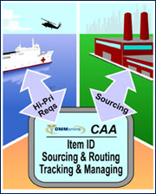


Army Use Case- Ordering a Medical Repair Part
5
AAC
FSC
4
1
E-Commerce Sourced (ECAT, PVM, etc.)
3
2
1
2
NSMR, Non-Medical FSC, Stocked Items
3
Non-Medical DVD, Direct Shipment
4
Notes:
Now I will explain in a very basic way how a medical order travels thru the multiple systems until is delivered to the customer.
E-commerce fulfilled order.
First the order is place on GCSS-A the Army system of record.
After the order goes thru services business process and validation the order goes thru the trap to the DLA transaction services the router to be routed to the correct commodity this is done because SMS is not commodity based so it is sorted out internally by DLA.
After is sent to the medical by the router it arrives at the TRAP the Contingency automated application the first step right out the door is a decision point to decide if the part will be source by the trap using an ECOMMERCE solution or it will be sent back to EBS our system of record to do a traditional DVD.
If the NSN, DODAAC and the PN is source by an E-commerce solution the trap will send it to the correct sourcing application this is sent directly to the vendor.
After the vendor acknowledges and fulfill the order the vendor ships the order directly to the customer shipping DODAAC.
Other orders.
For all order they will follow the same traction, but it will not be fulfilled by the trap or bypass the trap entirely.
It will travel from GCSS-A thru DAAS to the DLA router, but it will stay in EBS for traditional DVD fulfillment after these process is completed is sent to the customer from the vendor. If the item is stocked DLA will send it to the customer from the stockage in hand this is determined by the AAC for example D. The HMMSS tested this already.

Slide 35
Current State
Slide Classification: Classification goes here
Operational Challenges
Known Issues
Currently the operational forces face a significant challenge when ordering repair parts.
    Obsolesce
    Lack of E-commerce solution
    Long lead times
    Limited acquisition methods (DVD, GPC)
There are many obstacles that could lead to an inability to source items.
  Issues include
    TAA compliance
    Proprietary information
    NDA’s
    Feasibility of service
    Systems of Record Limitations
Repair Parts
Way Ahead
Possible impacts
Services and Industry play a crucial role on the readiness of the services.
    Identifying schedule repair parts at the beginning of the acquisition.
    Providing a list of recurrent repair parts to the developers.
    Working with acquisition stakeholders to maximize E-commerce solutions.
The e-commerce solutions have positive impacts to
    Lead times
    Budget Planning
    Resource reliability

Slide 36
Army Theater Authorized Stockage List (TASL) Use Case
Impacts
Reduced Lead times
Reliability on resources
Increased readiness

Slide 37
Unclassified End Slide: Option 1

Slide 38
Unclassified Cover Slide
Joint Medical Acquisition Talks
Diagnostic X-Ray Team (FSDA)
Capital Equipment Division
Mario Buonanoce​
July 15, 2026
Last updated: February 03, 2026

Slide 39
Capital Equipment Division
Capital Equipment Division – FSD
Michael Rettano
Diagnostic X-Ray – FSDA
Mario Buonanoce
Turnkey – FSDB
Cheryl Zekas
Ft. Detrick – FSDD
John Jackson
Critical Care – FSDC
Neil Hilton

Slide 40
Diagnostic X-Ray Integrated Supply Team (IST)
Mario Buonanoce
Chief, Diagnostic X-Ray Team
Diemhong (Hong) Walters
Lead Contracting Officer
Audrey Thomas-Gahring
Lead Biomedical Engineer
Shawn Carney
Contracting Officer
Jake Carter
Biomedical Engineer
Michael Baron
Contracting Specialist
Evan Elko
Biomedical Engineer
Alex Gaw
Biomedical Engineer
Kelly Bayha
Contracting Specialist
Albin Jojo
Biomedical Engineer
Emma Coyle
Contracting Specialist
Zehra Khan
Biomedical Engineer
Thomas Hinchliffe
Contracting Specialist
Padma Pothirajan
Biomedical Engineer
Ramata Mansaray
Contracting Specialist
Scott Younger
Biomedical Engineer

Slide 41
Program Overview
Radiology and Imaging Systems Program:
  $6.5B Multiple Award Program
  Joint program with the Department of Veterans Affairs (VA) National Acquisition Center (NAC)
  Recognized by the Office of Management and Budget (OMB) as best-in-class across the entire federal government.
  Provides for the supply of radiology and imaging systems, and subsystems, in addition to the maintenance services, training, repair parts, accessories, and incidental services related to the purchase of the equipment.
    Computed Tomography (CT)
    Magnetic Resonance Imaging (MRI)
    Digital Radiography (DR)
    Nuclear Medicine
    Ultrasound
    Mammography
    Radiographic Fluoroscopy
  Support contingency initiatives for deployable radiology equipment.
  Electronic Catalog (ECAT) order capability for applicable items.

Slide 42
Program Overview (Cont.)
Patient Monitoring and Capital Equipment Program:
  $900M Multiple Award Program
  Provides for the supply of patient monitoring systems, pharmacy automation systems, anesthesia systems, infant care products, critical care products, and subsystems, in addition to any networking/interfacing, upgrades, repair parts, installation, incidental services, accessories, and maintenance related to the purchase of the equipment.
    Patient Monitoring: Bedside Monitoring, Central Monitoring, Vital Signs Monitoring, Electrocardiograph (ECG), stress test systems.
    Pharmacy Automation: Point of Use Systems, Refill Center Systems, and Patient Queuing Systems.
    Integrated Operating Room (IOR): Surgical lights, flat panel arms, integration devices, equipment booms, anesthesia booms, suction solutions, monitors, camera systems, insufflators, nurses' workstations.
    Critical Care: Defibrillators, Defibrillator/Monitors, and Ventilators.
    Infant Care: Warmers and Incubators.
  Support contingency initiatives for deployable monitoring equipment.
  Electronic Catalog (ECAT) order capability for applicable items.

Slide 43
Program Overview (Cont.)
Program Eligibility:
  Any responsible vendor that can meet all solicitation requirements and whose offered pricing can be determined fair and reasonable is eligible for contract award.
  The contract award process may take 8 months to 2+ years.
Program Opportunities:
  Radiology and Imaging Systems Program – Generation III solicitation was issued November 2025 with a March 2026 closing date.
    Anticipated solicitation open season January 2028.
  Patient Monitoring and Capital Equipment – Generation IV solicitation is anticipated to be issued mid-CY2027.
Opportunity Sources:
  SAM.gov – https://sam.gov/
    Ordering Agency Identifier: SPE2D1 / 36H797
    NAICS: 334517 (RAD) / 334510 (PMCE)
    PSC: 6525
  DLA Internet Bid Board System - https://www.dibbs.bsm.dla.mil//

Slide 44
Program Overview (Cont.)
Supported Customers:
  Defense Health Agency (DHA)
  Army
  Navy
  Air Force
  Marine Corps
  Veteran Administration (VA)
  National Institutes of Health (NIH)
  Bureau of Prisons
  Foreign Military Sales (FMS)
  Department of Heath and Human Services (HHS)
  Uniformed Services University of the Health Sciences (USUHS)
Location Support Capability:
  CONUS and OCONUS

Slide 45
Delivery Order Process
DLA Receives Customer Requirement
Solicitation (RFO) Development
Solicitation Issuance
Solicitation Closes
Initial Offer Evaluations
Discussions with Offerors
Final Offer Evaluations
Award Decision & Issuance

Slide 46
Delivery Order Lead Times
Types of Projects and Estimated Lead Times:
Project Type | Acquisition Method | Estimated Timeline to Award
Routine Delivery Order | Competitive | 60-180 days from Solicitation Closing Date or DLA Package Acceptance, if Customer led
 | Sole Source/Limited Sources | 90-180 days from DLA Package Acceptance and Adequate LSJ Submission
Full Hospital Replacement | Competitive | 365-545 days from Solicitation Closing Date
General Equipment Standardizations | Competitive | 180-300 days from Solicitation Closing Date
Deployable Equipment Standardizations | Competitive | 180-365 days from Solicitation Closing Date

Slide 47
Sales History
The capital equipment division has approximately $550M in sales annually.
FSDA makes up approximately 25%-35% of those sales.

Slide 48
Sales History (Cont.)

Slide 49
Sales History (Cont.)

Slide 50
Sales History (Cont.)

Slide 51
Sales History (Cont.)

Slide 52
Sales History (Cont.)

Slide 53
Questions
Additional questions can be directed to Mario Buonanoce and Diemhong Walters using the contact information provided below:
  Email: Mario.Buonanoce@dla.mil Phone: 445-737-0968
  Email: Diemhong.Walters@dla.mil Phone: 445-737-9013

Slide 54
Unclassified End Slide: Option 1

Slide 55
Joint Medical Acquisition Talks
FSDB – Turnkey Integrated Supply Team (IST)
Zahkiyah Taylor, Lead Contracting Officer
July 15, 2026
Last updated: February 03, 2026

Slide 56
Capital Equipment Division
Capital Equipment Division – FSD
Michael Rettano
Diagnostic X-Ray – FSDA
Mario Buonanoce
Diemhong Walters (KO)
Turnkey – FSDB
Cheryl Zekas
Zahkiyah Taylor (KO)
Critical Care – FSDC
Neil Hilton
Anthony Giunta (KO)
Ft. Detrick – FSDD
John Jackson
Christina Heller (KO)
Sabrina Pineda
Embedded TVLS
Diana Kinnard Embedded TVLS
Amy Connor Embedded TVLS

Slide 57
Who We Are
Turnkey IST (FSDB) Personnel
Cheryl Zekas
Chief, Turnkey IST
Zahkiyah Taylor
Lead KO (Unlimited)
Charlene Harley
Lead Engineer
Marie Serrano - KO
Christine Welker - KO
Colleen Quinn
Rebecca Adams
Alyssa Pecillo
Juliana Scafidi
Marco Sifoni
Ajin Abraham
Kadeem Dwyer
Christopher Mikus
Nicolas Perrusquia
Bohdan Tkachov

Slide 58
FSDB Product Lines
DIN-PACS IV
Extended & Turnkey Installation
Cardiology
Radiology
System Maintenance
Vendor Neutral Image Archives (VNA)
Humanitarian Efforts (OCONUS)
Engineering Support
Open Market
Electronic Catalog (ECAT)
Voice Dictation
Digital Dental
Commercial Maintenance
Ophthalmologic Laser Surgery Systems
Notes:
Add pictures of service members
Verify insignia
Transparent

Slide 59

Our Customers
Supporting
Air Force, Army, Army National Guard, Navy, Coast Guard, Marines
Federal Bureau of Prisons
Defense Health Agency
Indian Health Services
Department of Veterans Affairs
Worldwide Customer Support
CONUS
OCONUS
Notes:
Add pictures of service members
Verify insignia
Transparent

Slide 60

What is DIN-PACS?
Digital Imaging Network-Picture Archive Communication Systems
DIN-PACS is the Government’s official term, distinguishing it from the commercial industry’s term PACS
DIN‑PACS provides secure, interoperable, enterprise‑wide medical imaging management for the DoD and VA, enabling unified image access across departments, facilities, and global operations
DIN‑PACS contracts, awarded by FSDB & VA NAC, enable Medical Treatment Facilities and VA Medical Centers to access a service member’s medical imaging and health records anywhere in the world
Notes:
DIN‑PACS (Digital Imaging Network–Picture Archive Communication Systems) is the U.S. Government’s official term, distinguishing it from the commercial industry’s use of PACS.
DIN‑PACS is the Digital Backbone of Medical Imaging
DIN‑PACS — the Government’s enterprise‑wide imaging operating system — extends far beyond the commercial concept of PACS, which traditionally focuses on radiology image storage and retrieval.
It stores, manages, routes, and displays medical images across the entire healthcare enterprise, supporting multi‑department, multi‑facility, and global medical operations.
DIN‑PACS contracts, awarded by FSDB & VA NAC, enable DHA Military Treatment Facilities, Hospitals, and VA Medical Centers to access a service member’s medical imaging and health records anywhere in the world.
Unlike commercial PACS, DIN‑PACS is built for interoperability, security, and worldwide deployment across DoD and VA environments.

Slide 61
History of DLA DIN-PACS Program
Joint Program with the Defense Logistics Agency and the Department of Veterans Affairs National Acquisition Center
  DIN-PACS I multiple award program awarded in 1998
  DIN-PACS II multiple award program awarded in 2004
  DIN-PACS III multiple award program awarded in 2011
  DIN-PACS IV multiple award program awarded in 2016
    Current Program

Slide 62
DIN-PACS IV
Radiology & Cardiology DIN-PACS and Maintenance
Seven (7) Indefinite-Delivery, Indefinite-Quantity Contracts (IDIQ)
  Multiple Award Program
  Up-to ten (10) year contracts
  Requirements established by the customer
  All vendors that met solicitation requirements were awarded a contract (currently closed)
  Requirements are competed amongst all contract holders
Supported by Biomedical Engineering and Contracting Teams

Slide 63
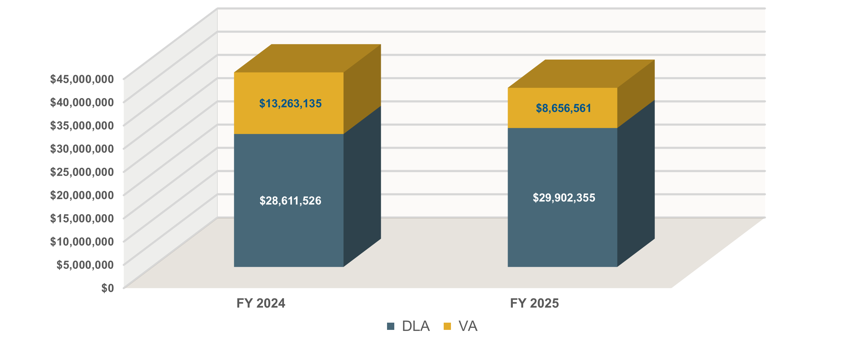
FSDB FY 2024 – 2025 Sales
$41,874,660.14
$38,558,916.11

Slide 64

Future Program Offerings: DIN-PACS V
DIN-PACS V
Specialties:
Cardiology
Dental
Dermatology
Endoscopy
Nuclear Medicine
OB-GYN
Oncology
Ophthalmology
Pathology
POCUS
Radiology
Sleep Lab
Veterinary
Vendor Neutral Image Archives
Support:
DINPACS Maintenance
Extended and Turnkey Installation
Solicitation# SPE2D1-26-R-0001
Estimated issue date: Late July / Early August
Estimated closing date: Seven years following issue date

Slide 65
Acquisition Methods & Timelines
IDIQ: 6 - 9 Months after receipt of proposal
ECAT Contract: 6 - 9 Months after receipt of proposal
Long‑term IDIQ contracts run for a fixed performance period (up to 10 years)
Ophthalmologic lasers are awarded via the DLA Troop Support Medical Electronic Catalog
Acquisition Type
Open Market: 240 – 365 Days after receipt of requirement
Request for Offer: 365 – 545 Days after receipt of requirement
Open market buys use a public RFQ/RFP process where any qualified vendor may submit bids
Individual delivery orders are competed through the Request for Offer (RFO) process

Slide 66
Contract Modifications
Process
  Email modification requests to the appropriate government contract administrator POC
    Complete and attach “Attachment B” and “Attachment C” and any additional required price support documentation within email, if applicable
    Very minor contract modifications may not require both “Attachment B” and “Attachment C.” Ask your gov contract administrator POC if you are unsure
Timeline
  Timeline can vary based upon:
    Number of new items being added (price analysis is determined using a sample of total items being added)
    Number of varied changes being requested (Add new items, delete old items, revise part numbers, change item descriptions, etc.)
    Due to the varied nature of contract mod requests, DLA recommends vendors submit no more than one “large” price book request per quarter
    Minor contract modifications will be processed within 30 days (Vendor POC information update, address update, other small administrative changes, etc.)

Slide 67
Price Book \ Quote Management
Price Book Best Practices
Price book format and formulas must remain uniform
  No edits to the Price book format or formulas
  No additional tabs are to be added
  Ensure the VLOOKUP is fully functional (no errors on Excel sheet) prior to sending to the DLA Contracting POC
Quote Best Practices
  Ensure quoted items are in official Government price book
    Exception for zero-dollar items
  Ensure line item includes itemized pricing

Slide 68
FSDB Primary Points of Contact
NAME | TITLE | EMAIL
Cheryl Zekas | Supervisor/IST Chief | Cheryl.Zekas@dla.mil
Zahkiyah Taylor | Contracting Officer | Zahkiyah.Taylor@dla.mil
Charlene Harley | Lead Biomedical Engineer | Charlene.Harley@dla.mil

Slide 69
Q & A

Slide 71
Unclassified Cover Slide
Critical Care Integrated Supply Team (IST) Overview
Neil Hilton, IST Chief​ July 15, 2026
Last updated: February 03, 2026

Slide 72
Capital Equipment Division
Capital Equipment Division – FSD
Michael Rettano
Diagnostic X-Ray – FSDA
Mario Buonanoce
Diemhong Walters (KO)
Turnkey – FSDB
Cheryl Zekas
Zahkiyah Taylor (KO)
Critical Care – FSDC
Neil Hilton
Anthony Giunta (KO)
Ft. Detrick – FSDD
John Jackson
Christina Heller (KO)
Sabrina Pineda
Embedded TVLS
Diana Kinnard Embedded TVLS
Amy Connor Embedded TVLS

Slide 73
Programs & Product Lines
Slide Classification: Classification goes here
Corporate Exigency Contracts (CEC)
Patient Monitoring & Capital Equipment (PMCE)
Equipment Electronic Catalog (ECAT)
Non-Commercial Medical Equipment (NCME)
Aspirators
Dental X-Ray Systems (Digital & Analog)
Infusion Pumps
Medical Lasers
Pulse Oximeters
Robotic Surgery Systems
Resuscitators
Suction Apparatuses
Equipment Using Ultrasound Technology
Defibrillators
Defibrillator/Monitors
Integrated Operating Room (IOR) Systems
Ventilators
Dual-Aeromedically Certified:
  Defibrillators
  Suction Apparatuses
  Ventilators
Non-Developmental Medical Equipment
Deployable Oxygen Systems

Slide 74

Programs & Product Lines
Equipment ECAT
Shared Solicitation
Hospital Supply Division
Expanded Scope
  Examination tables/surgical tables
  Hospital beds/chairs/stretchers
  Laboratory analyzers
  Litters
  Sterilizers
  Medical refrigerators and other medical storage systems
  Ophthalmic equipment, including but not limited to, ophthalmic imaging systems, optical coherence tomography (OCT) and optical coherence tomography angiography (OCTA) systems, ophthalmic picture archiving, ophthalmic picture archiving and communication systems (PACS), polarimetry imaging systems, software, equipment, workstations for, and maintenance of such systems.
  Dental equipment, including but not limited to, dental PACS, software, equipment, workstations for, and maintenance of such systems.
  Medical simulation equipment that is used for training purposes
Notes:
Explain that scope is shared for contract holders. New proposals are assigned based on percentage of offering.

Slide 75
Programs & Product Lines
CEC & NCME
Corporate Exigency Contract (CEC)
Dual-Aeromedical Certification
    Safe-to-Fly (STF)
    Airworthiness Release (AWR)
Access to inventory
Time-phased delivery requirements
Noncommercial Medical Equipment (NCME)
Devices/Systems must be noncommercial at time of award
Consumables/Accessories may be commercial
Defense Contract Audit Agency (DCAA)

Slide 76
General Overview
Slide Classification: Classification goes here
Sales
  FY25 $218 Million
Contract Information
  Manage approximately 38 large, long term Indefinite Delivery, Indefinite Quantity (IDIQ) contracts
  Dollar values range from $10 Million to $800 Million.
Customers
  Defense Health Agency (DHA)
  Army
  Navy
  Air Force
  Marine Corps
  Veteran Administration (VA)
  National Institutes of Health (NIH)
  Bureau of Prisons
  Foreign Military Sales (FMS)

Slide 77
FSDC Sales FY23-FY25
Slide Classification: Classification goes here

Slide 78
Ordering Procedures
Slide Classification: Classification goes here
ECAT
Manual Equipment ECAT Orders
  Complex and/or highly configurable equipment
    Surgical Robot Systems
    Medical Lasers
    Digital Dental Systems
    Maintenance
Limited Source Requirements
Competitive Requirements Valued at or above the SAT
Competitive Requirements Valued under the SAT
Funding Document
Equipment Customer Checklist
Quote
Customer Best Value Determination (CBVD)
Statement of Work (SOW)
Installation & Incidental Services Approval Form*
IA/RMF/Cybersecurity Documents
Funding Document
Equipment Customer Checklist
Salient Characteristics Questionnaire or SOW*
Any Market Research Quotes
Installation & Incidental Services Approval Form*
IA/RMF/Cybersecurity Documents
Funding Document
Equipment Customer Checklist
Quote
Limited Source Justification (LSJ) Worksheet
SOW*
Installation & Incidental Services Approval Form*
IA/RMF/Cybersecurity Documents
*If applicable

Slide 79
Ordering Procedures
Slide Classification: Classification goes here
PMCE
Customer
TVLS
FSDC
Award
Request for Offers (RFO)
  Identifying Requirements
  Developing RFO Packages
  Issuing RFO
  Offer Evaluation
  Preparing Requisition Package
  Submitting Requisition Package to DLA
  DLA Acceptance of Package
  DLA Review
  Selection and Order Issuance
  RFO Lead
  DHA
    Procurements less than $6.5 Million
  DLA
    Any procurement exceeding $6.5 Million.
    Full Hospital Patient Monitoring
    Any procurement involving First Article Testing (FAT)
    Equipment modified to be deployable
    Standardizations

Slide 80
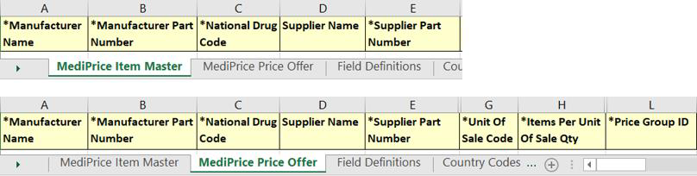
Contract Modification Process
Slide Classification: Classification goes here
ECAT
Item Additions
  Quarterly requests
  Other than Certified Cost & Pricing Data
  Price Reasonableness Determinations
  Product Literature, Specifications, etc.
  Item Deletions
  May be requested at any time
  Item Master Sheet only
  Key Fields must match current records
  Item Updates Unrelated to Price Increases
  May be requested at any time
  Key Fields must match current records
  Changes to Key Fields require deletions and adds

Slide 81
Contract Modification Process
Slide Classification: Classification goes here
ECAT
Price Changes
  Decreases
    May be requested at any time
  Increases
    Economic Price Adjustment (EPA)
      See specific solicitation
    Other than Certified Cost & Pricing Data
    Prices must be determined Fair and Reasonable before contract modifications
    It is the responsibility of the contractor to ensure that the unit price of the item matches the contractor’s current contract price prior to acknowledgement of an order.

Slide 82
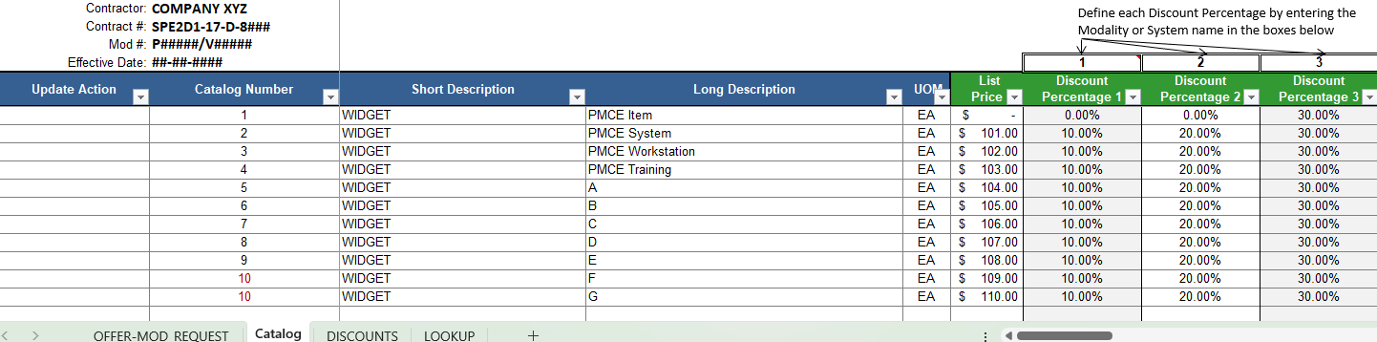
Contract Modification Process
Slide Classification: Classification goes here
PMCE
PMCE Price Book
  Must submit all proposed changes via the PMCE Price Book
ECAT Administrative Contracts
  Submit proposed changes via the MediPrice Template after scope determination

Slide 83
Opportunities
Slide Classification: Classification goes here
Current
PROGRAM | RFP NUMBER | CONTRACT LENGTH | RFP CLOSING DATE
Equipment ECAT Gen V | SPE2DH-21-R-0002 | 5-Year Base Period | Dec 2026
Future
PROGRAM | RFP NUMBER | EST. CONTRACT LENGTH | EST. ISSUE DATE
CEC – Ventilator | TBD | 1-Year Base Period & Four 1-Year Option Periods | TBD
Equipment ECAT Gen VI | SPE2DH-26-R-0002 | 5-Year Base Period & One 5-Year Option Period | Dec 2026
PMCE Gen II | TBD | 5-Year Base Period & One 5-Year Option Period | TBD

Slide 84
Q&A

Slide 85
Unclassified End Slide: Option 1

Slide 86
Fort Detrick Contracting Branch
John R. Jackson, Branch Chief​ July 15, 2027
Last updated: February 03, 2026

Slide 87
Capital Equipment Division
Capital Equipment Division – FSD
Micheal Rettano
Anthony Guinta (KO) - FSDC
Diagnostic X-Ray – FSDA
Mario Buonanoce
Turnkey – FSDB
Cheryl Zekas
Critical Care – FSDC
Neil Hilton
Forward Cell – FSDD
John R. Jackson
Sabrina Pineda
Embedded TVLS
Kinnard, Diana Embedded TVLS
QSCA CS Branch
Ft Detrick
Embedded TVLS

Slide 88
Fort Detrick Forward Cell - FSDD
Forward Cell - FSDD
John R. Jackson
Branch Chief
Christina Heller
Team Lead
CW3 Nomar Diazlebron
Biomedical Equip Liaison
CW3 Sarah Reeb
Biomedical Equip Liaison
Lucas Denault
Acquisition Specialist
Vincent Key
Acquisition Specialist
QSCA Branch
Embedded TVLS

Slide 89
Current Product Lines
Ft. Detrick Contracting FSDD
Radiology Maintenance
Radiation Therapy
Pharmacy Automation

Slide 90
General Overview
Forward Cell - FSDD
Sales
  Approximately $123* Million per year
General Product Line Information
  Joint DLA/VA program: Radiation Therapy
  Radiology and Imaging Service Maintenance Agreements (R&I SMA)
  Pharmacy Automation Product Line – part of the Patient Monitoring and Capital Equipment program.
Forward Cell
  DLA Troop Support’s “Forward Face” to the Customer
  Collocated with Key Customer Base at Ft Detrick
  *Includes Manual and ECAT orders

Slide 91
Radiology & Imaging Service Maintenance Agreements
Program
  Radiology and Imaging Program. Joint DLA/VA program co-administered by both agencies.
Customers
  DHA
  NIH
  NAIHS
  Other Federal Agencies
Importance
  Required to maintain current equipment in network for the life of the equipment
  Annual requirements
Challenges
  Funding / Timely Submission
  Inaccurate Quotes
    Missing Part Numbers
    Part Numbers not on contract

Slide 92
R&I Consolidation Efforts
Current Consolidations
  DHA Air Force: ~Dec. $20M
  DHA Navy: ~May. $21M
Future Consolidation(s): Est. FY27
  DHA Army: ~$28M
  or
  DHA Whole Enterprise: ~$70M

Slide 93
Radiation Therapy
Program
  This acquisition is a joint VA and DLA recurring requirement for Radiation Therapy Equipment.
    The purpose of the Radiation Therapy Equipment contract(s) is to obtain compatible, uniform, quality products at the best prices possible for the VA and Other Government Agencies.
  VA is the primary administrator
Items Purchased
  Radiation Therapy Systems, Upgrades and Accessories to include training and installation
  Computer-controlled and Imaging-guided Linear Accelerator Systems
  Specialized Stereotactic Radiosurgery Systems such as Gamma Knife
  Robotic Linear Accelerator Systems such as Cyberknife
  3D imaging-based Simulator Systems
  Record and Verify Systems
  3D Treatment Planning Systems
  Orthovoltage Systems and Accessories
  High Dose Rate (HDR) Brachytherapy Systems and Accessories
  Computer-controlled Quality Assurance devices
    3D water scanners
    3D humanoid phantoms
  Service Maintenance *New*
Challenges
  Long Lead Times
  Authority to Operate (ATO)

Slide 94
Pharmacy Automation
Program
  DLA Patient Monitoring and Capital Equipment Program
Items Purchased
  Pharmacy Automation includes
    Pharmacy Systems
    Inpatient/Outpatient
    Point of Use Systems
    Refill Center Systems
    Patient Queuing Systems
    Annual Maintenance.
Ordering
  Most Items available on ECAT
Challenges
  Long Lead Times for installation

Slide 95
QUESTIONS?

Slide 96
FSDD Points of Contact
John R. Jackson
Branch Chief
John.r.Jackson@dla.mil
Christina F. Heller
Acquisition Team Lead
Christina.Heller@dla.mil
CW3 Nomar Diazlebron
Biomedical Equipment Acquisitions LNO
Nomar.Diazlebron@dla.mil

Slide 98
OCONUS Locations
Placeholder slide. OCONUS locations presentation by Defense Health Agency.

Slide 99
ECAT Ordering
Placeholder slide. ECAT Ordering presentation by Defense Health Agency.

Slide 100
Life Cyle Management
Placeholder slide. Life Cycle Management presentation by Defense Health Agency.

Slide 101
AI in DoW Healthcare
Placeholder slide. AI in DoW Healthcare presentation by Defense Health Agency.

